Slide 1
General Health Rating Analysis
Team A
Bao Ngoc Dinh (Jane)
Tram Ngoc Le (Jennie)
Yanqi Shi (Chris)
Nicholas Mercogliano
Data Mining for Business – BYBG7967
Fall 2019 - Dec. 3rd , 2019

Slide 2
Outline
1. Introduction
2. Problem Statement
3. Methodology
4. Result Analysis
5. Conclusion
6. Appendix

Slide 3
INTRODUCTION

Slide 4
Abstract
With healthcare data covering all states and territories, from behavioral risk factors to environmental factors, we hoped to find out what makes a person consider him or herself as healthy?

Slide 5
Introduction: What is considered healthy?
Many factors can determine if someone is healthy
Some people have different interpretations of what is considered healthy

Slide 6
Introduction: Why Do We Care?
Answers that are not obvious may be useful to assess someone’s health
Data can be used to predict what people think is important, but is not important, and vice-versa
Results can be used to determine what areas people need more/less education in

Slide 7
PROBLEM STATEMENT

Slide 8
Problem Statement
This study aims to help people improve their perceived health knowledge by developing a model to predict which factors affect people’s health consciousness.
What factors (behavioral/ environmental....) make people think they are healthy ?

Slide 9
METHODOLOGY

Slide 10
Methodology Diagram
Methodology
Data Collection
Data Pre-processing
Variable Selection
Model Building
Evaluation
BRFSS &
Pollution Data
Calculate The Pollution Mean for Each State
8 Inputs
1 Target
Decision Tree & Bayesian Net
Model Accuracy

Slide 11

Data Collection
BRFSS 2018:
Collected through landline questionnaire
Health risk behaviors
Chronic diseases and conditions
Access to health care
Use of preventive health services related to the leading causes of death and disability in the United States
Pollution Dataset:
Daily pollution levels from all states and territories (Main: NO2, O3, SO2, and CO)
Notes:
Data used for this project came from the CDC's annual BRFSS survey. The data was collected in 53 states and US territories through landline and cell phone questionnaire.
2018 survey and 2013 survey were used to show the difference in a five-year gap regarding health consciousness. The BRFSS survey went back to 1980s but there were not as many attributes as the one in 2018. The 1980s survey was only conducted in 29 states, so 2013 is a better comparison to 2018.
BRFSS collects state-specific data on: health risk behaviors, chronic diseases and conditions, access to health care, and use of preventive health services related to the leading causes of death and disability in the United States
There are 330 attributes in the database, but we will not be using all of them to run our analysis. The attributes used will focus on demographic and health condition awareness of the surveyed people.

Slide 12

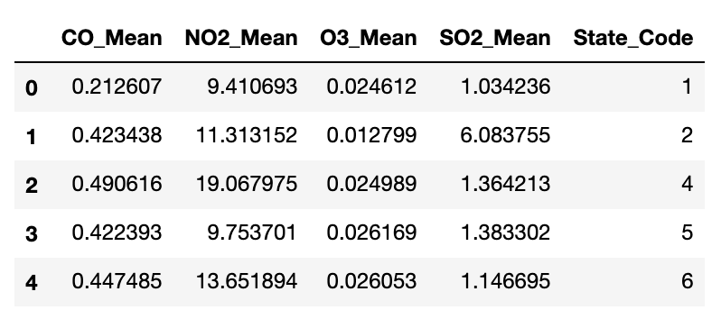
Data Preprocessing
Group the data by the State Code
Calculate the mean of the 4 pollution particles within each state

Slide 13
Variable Selection
Continuous Data
CO Mean, Poor Health, Drinks, Sleep
Flag Data
Exercises, Kidney Disease, Heart Attack
Nominal Data
Diabetes
Target Variable
“General Health Rating”
Notes:
Continuous Data
CO Mean, How many days of poor health (0-30 days/month), Average alcoholic drink per month (0-76 drinks/month), How much time sleep per night?(1-24 hours)
Flag Data
Exercised in the last 30 days (Yes/No), Have Kidney Disease (Yes/No), Ever Diagnosed with Heart Attack (Yes/No) Nominal Data
Nominal Data: Ever told you have diabetes?
Target Variable
“General Health Rating”
1. Excellent
2. Very Good
3. Good

Slide 14
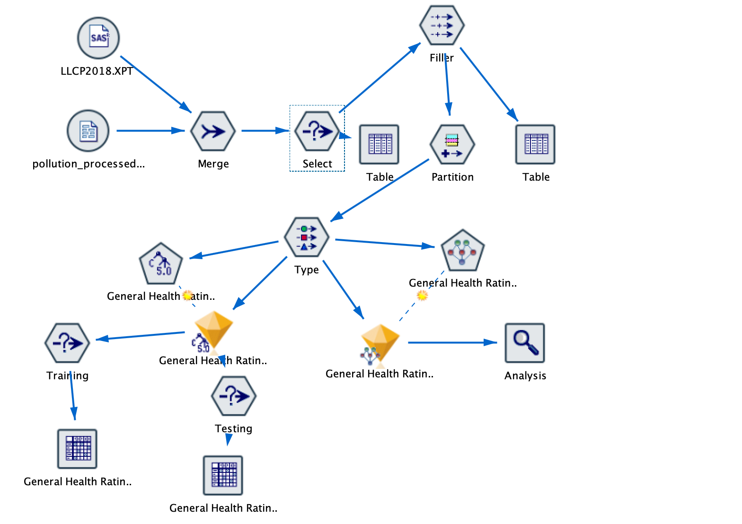
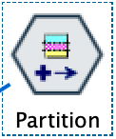
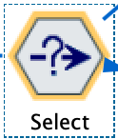
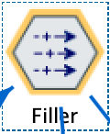
Model building
50/50 PARTITION
Discard null values/ Don’t knows/ Refused to answer
Replace values in a column for another value

Slide 15
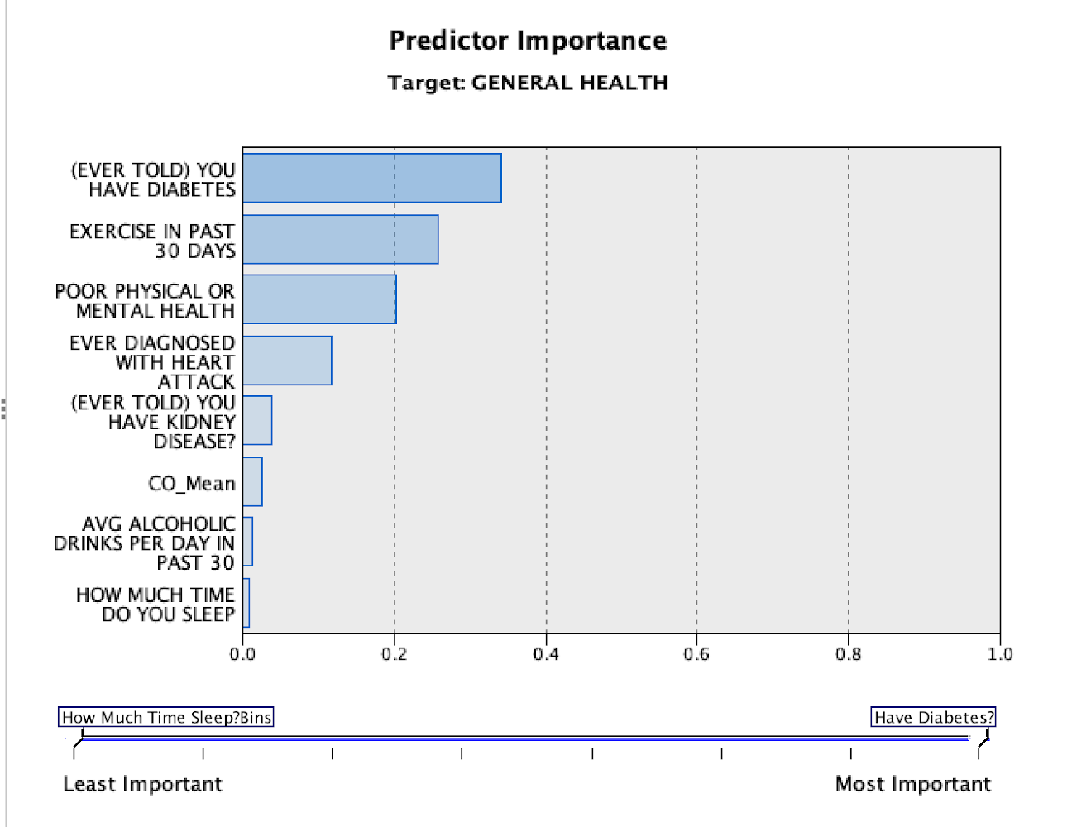
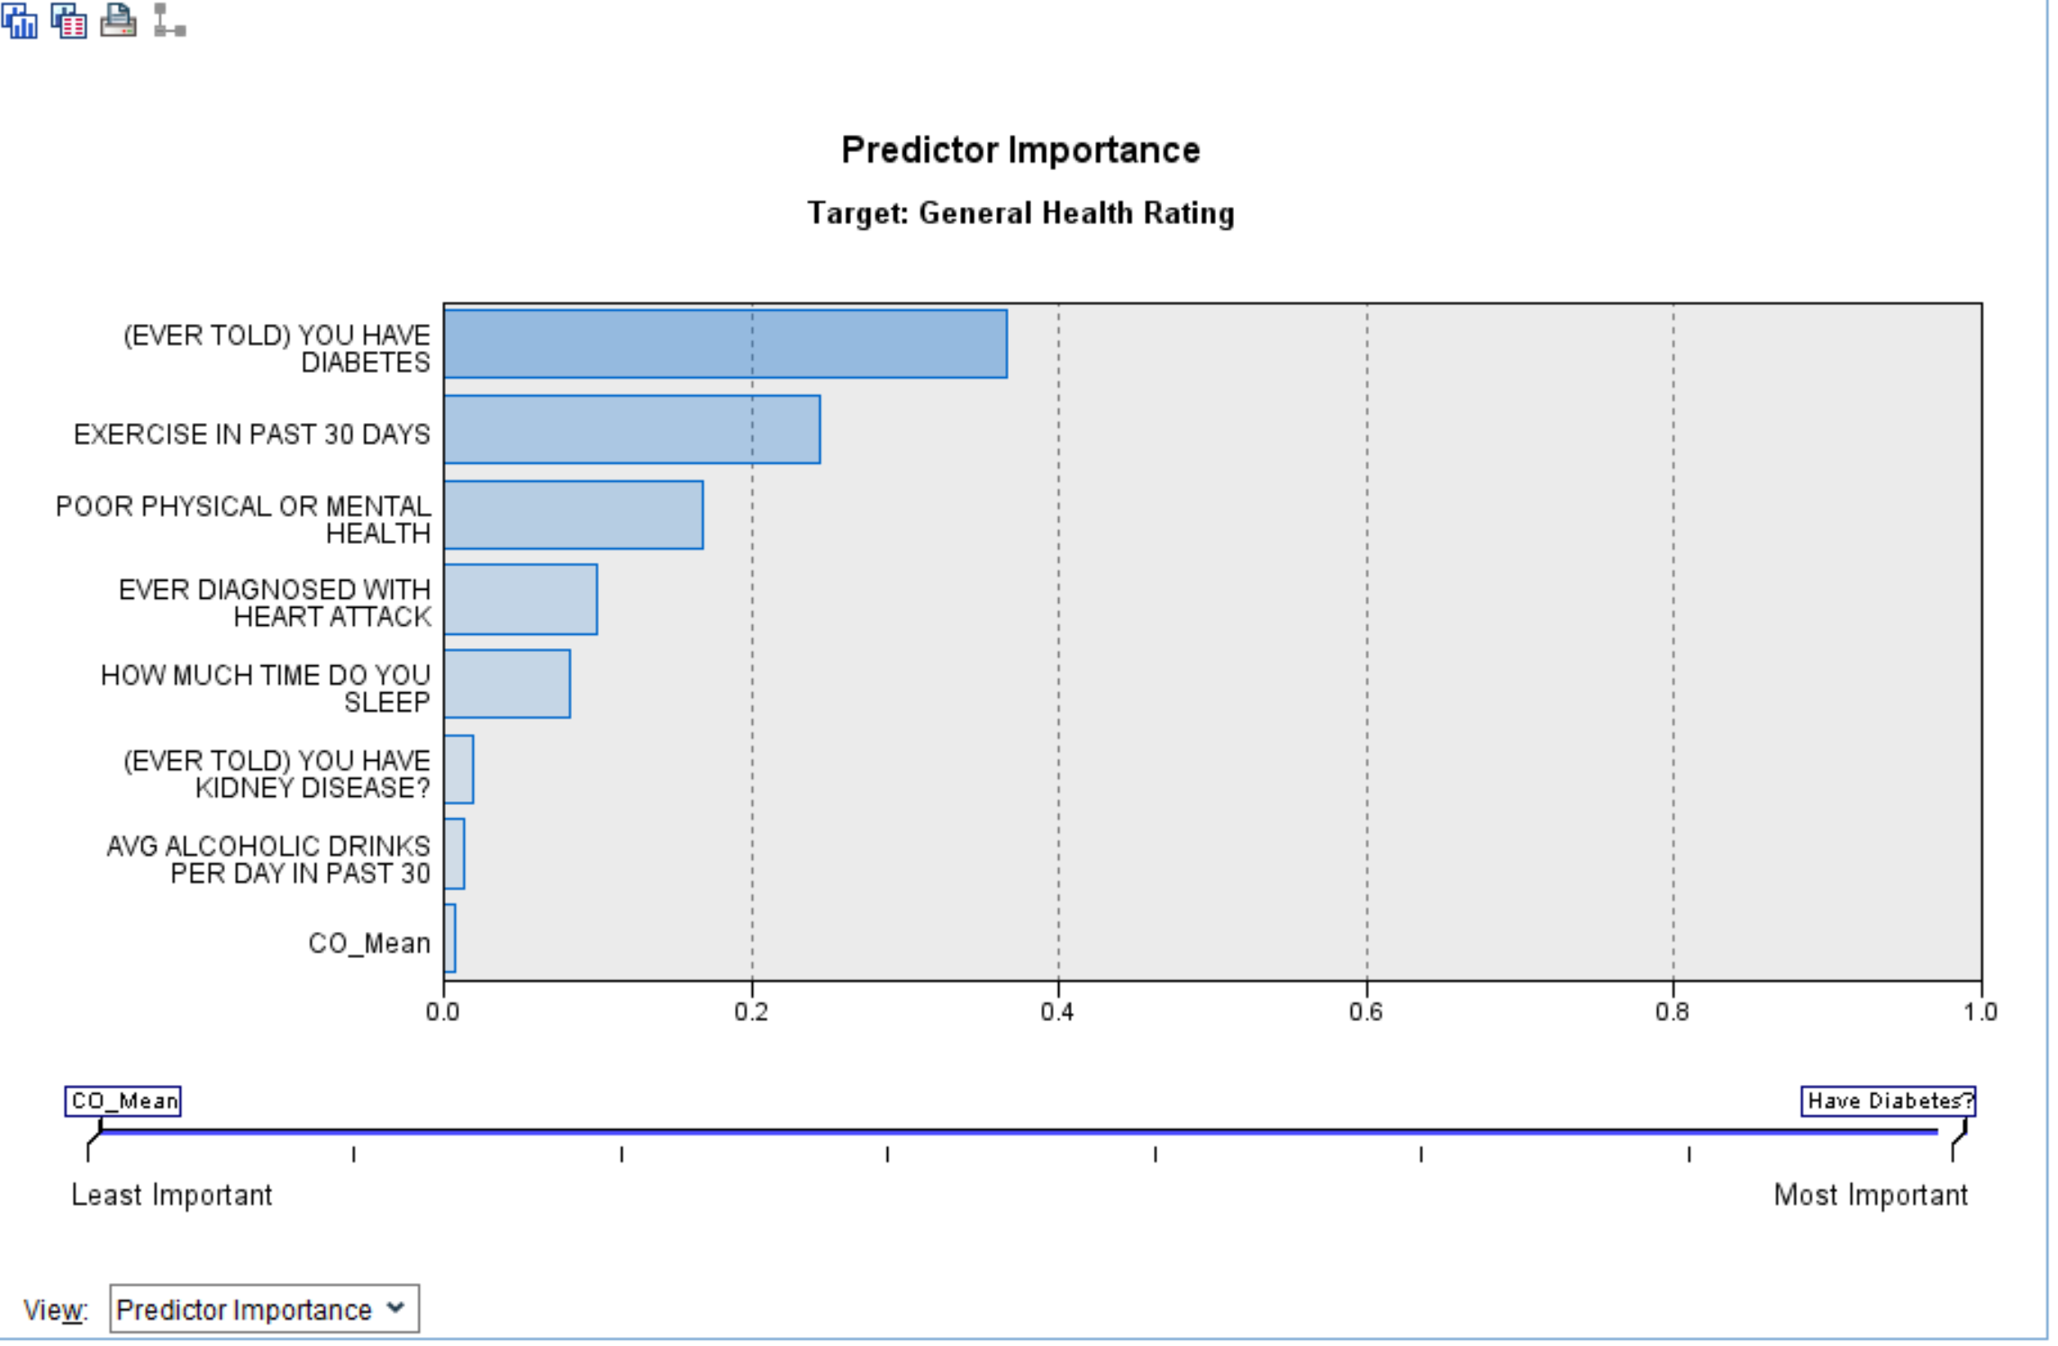
Model Evaluation: Predictor Importance
Bayes Net
Decision Tree
Notes:
After running Bayes Net and Decision Tree - The top three importance predictors are the same - Have diabetes ? exercise in past 30 days ? Days of poor physical or mental healths ?
CO_Mean seems to be more important in bayes net than decision tree - however, we will pick the model with better accuracy and analysis the result based on the model
Even though a smaller dataset is CO_mean are merged because we want to see if pollution area really affect people’s decision about their health rating but we found that CO_mean is not a significant indicator here.

Slide 16
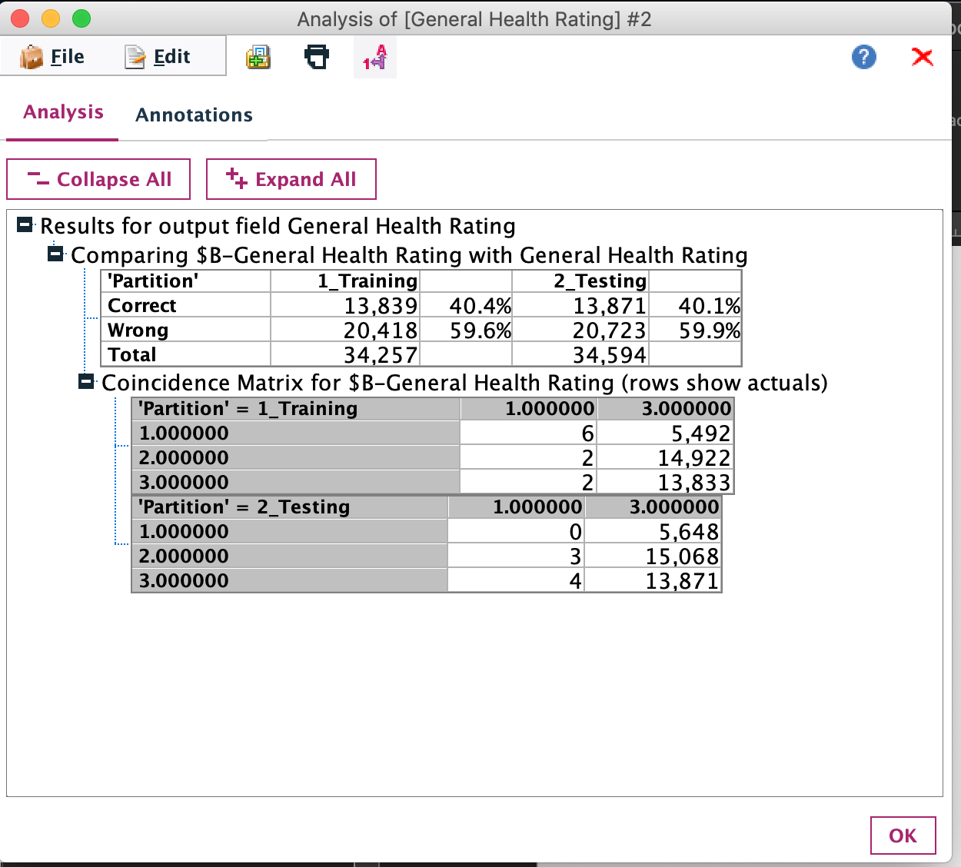
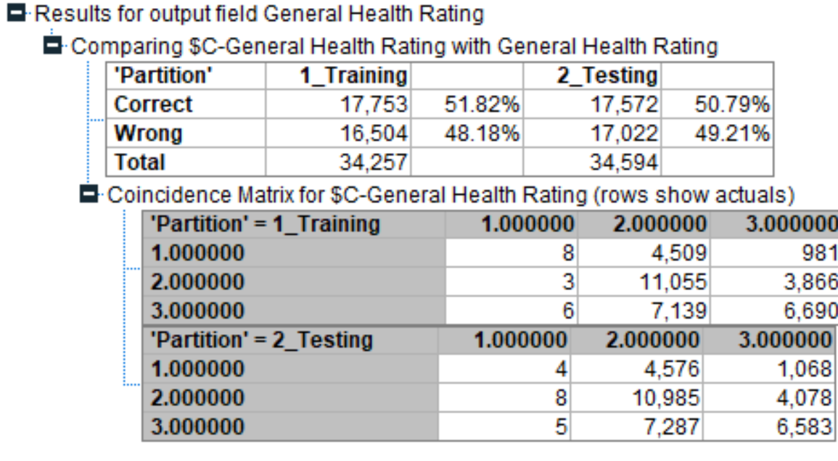
Model Evaluation: Accuracy Comparison
Bayesian Model Accuracy
Decision Tree Model Accuracy
Notes:
Decision Tree performed classification 10% better than bayesian models and they have the same top three indicators important so we will pick the Decision Tree model to analyze

Slide 17
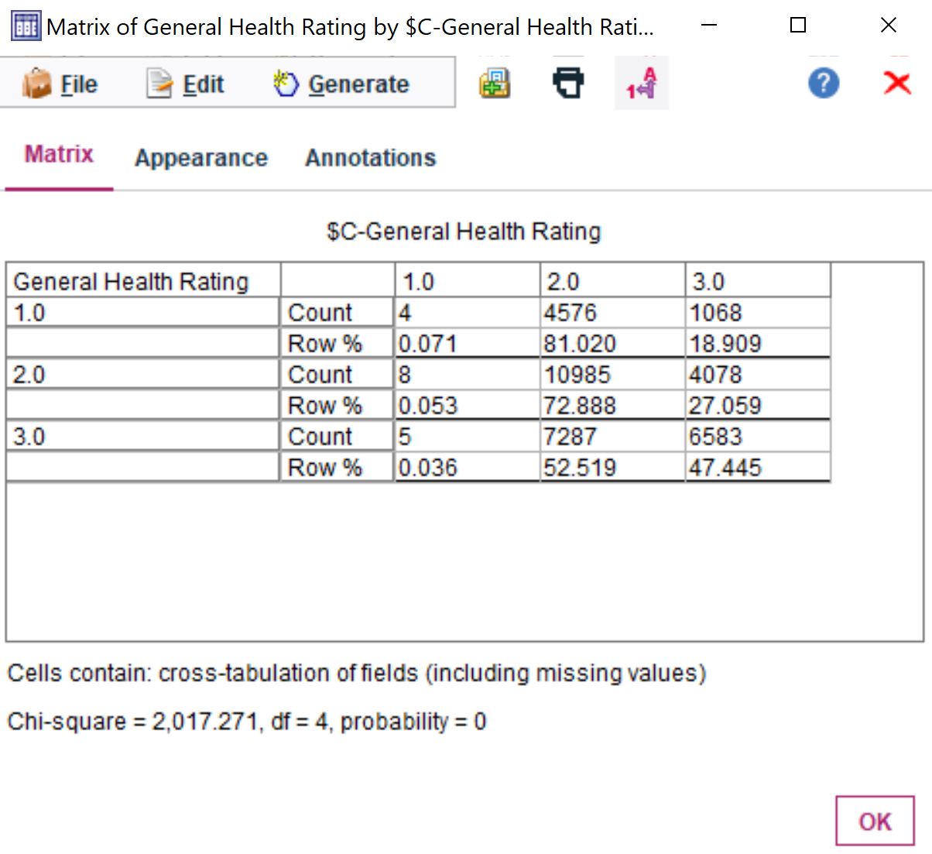
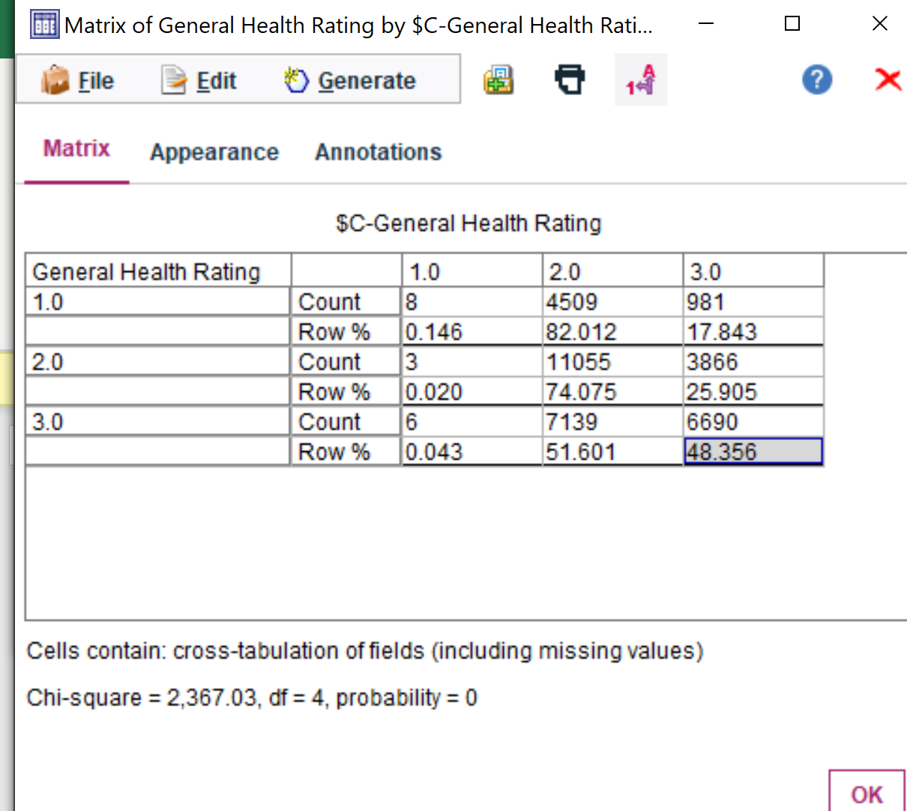
Model Evaluation: Decision Tree Confusion Matrices
MATRIX TESTING | MATRIX TRAINING
Testing Result:
Perform the best at General Health Rating - 2.0 “Very Good” (< 72% accuracy)
Perform the worst at General Health Rating -1.0 “Excellent” (<1% accuracy)

Slide 18
RESULT ANALYSIS

Slide 19
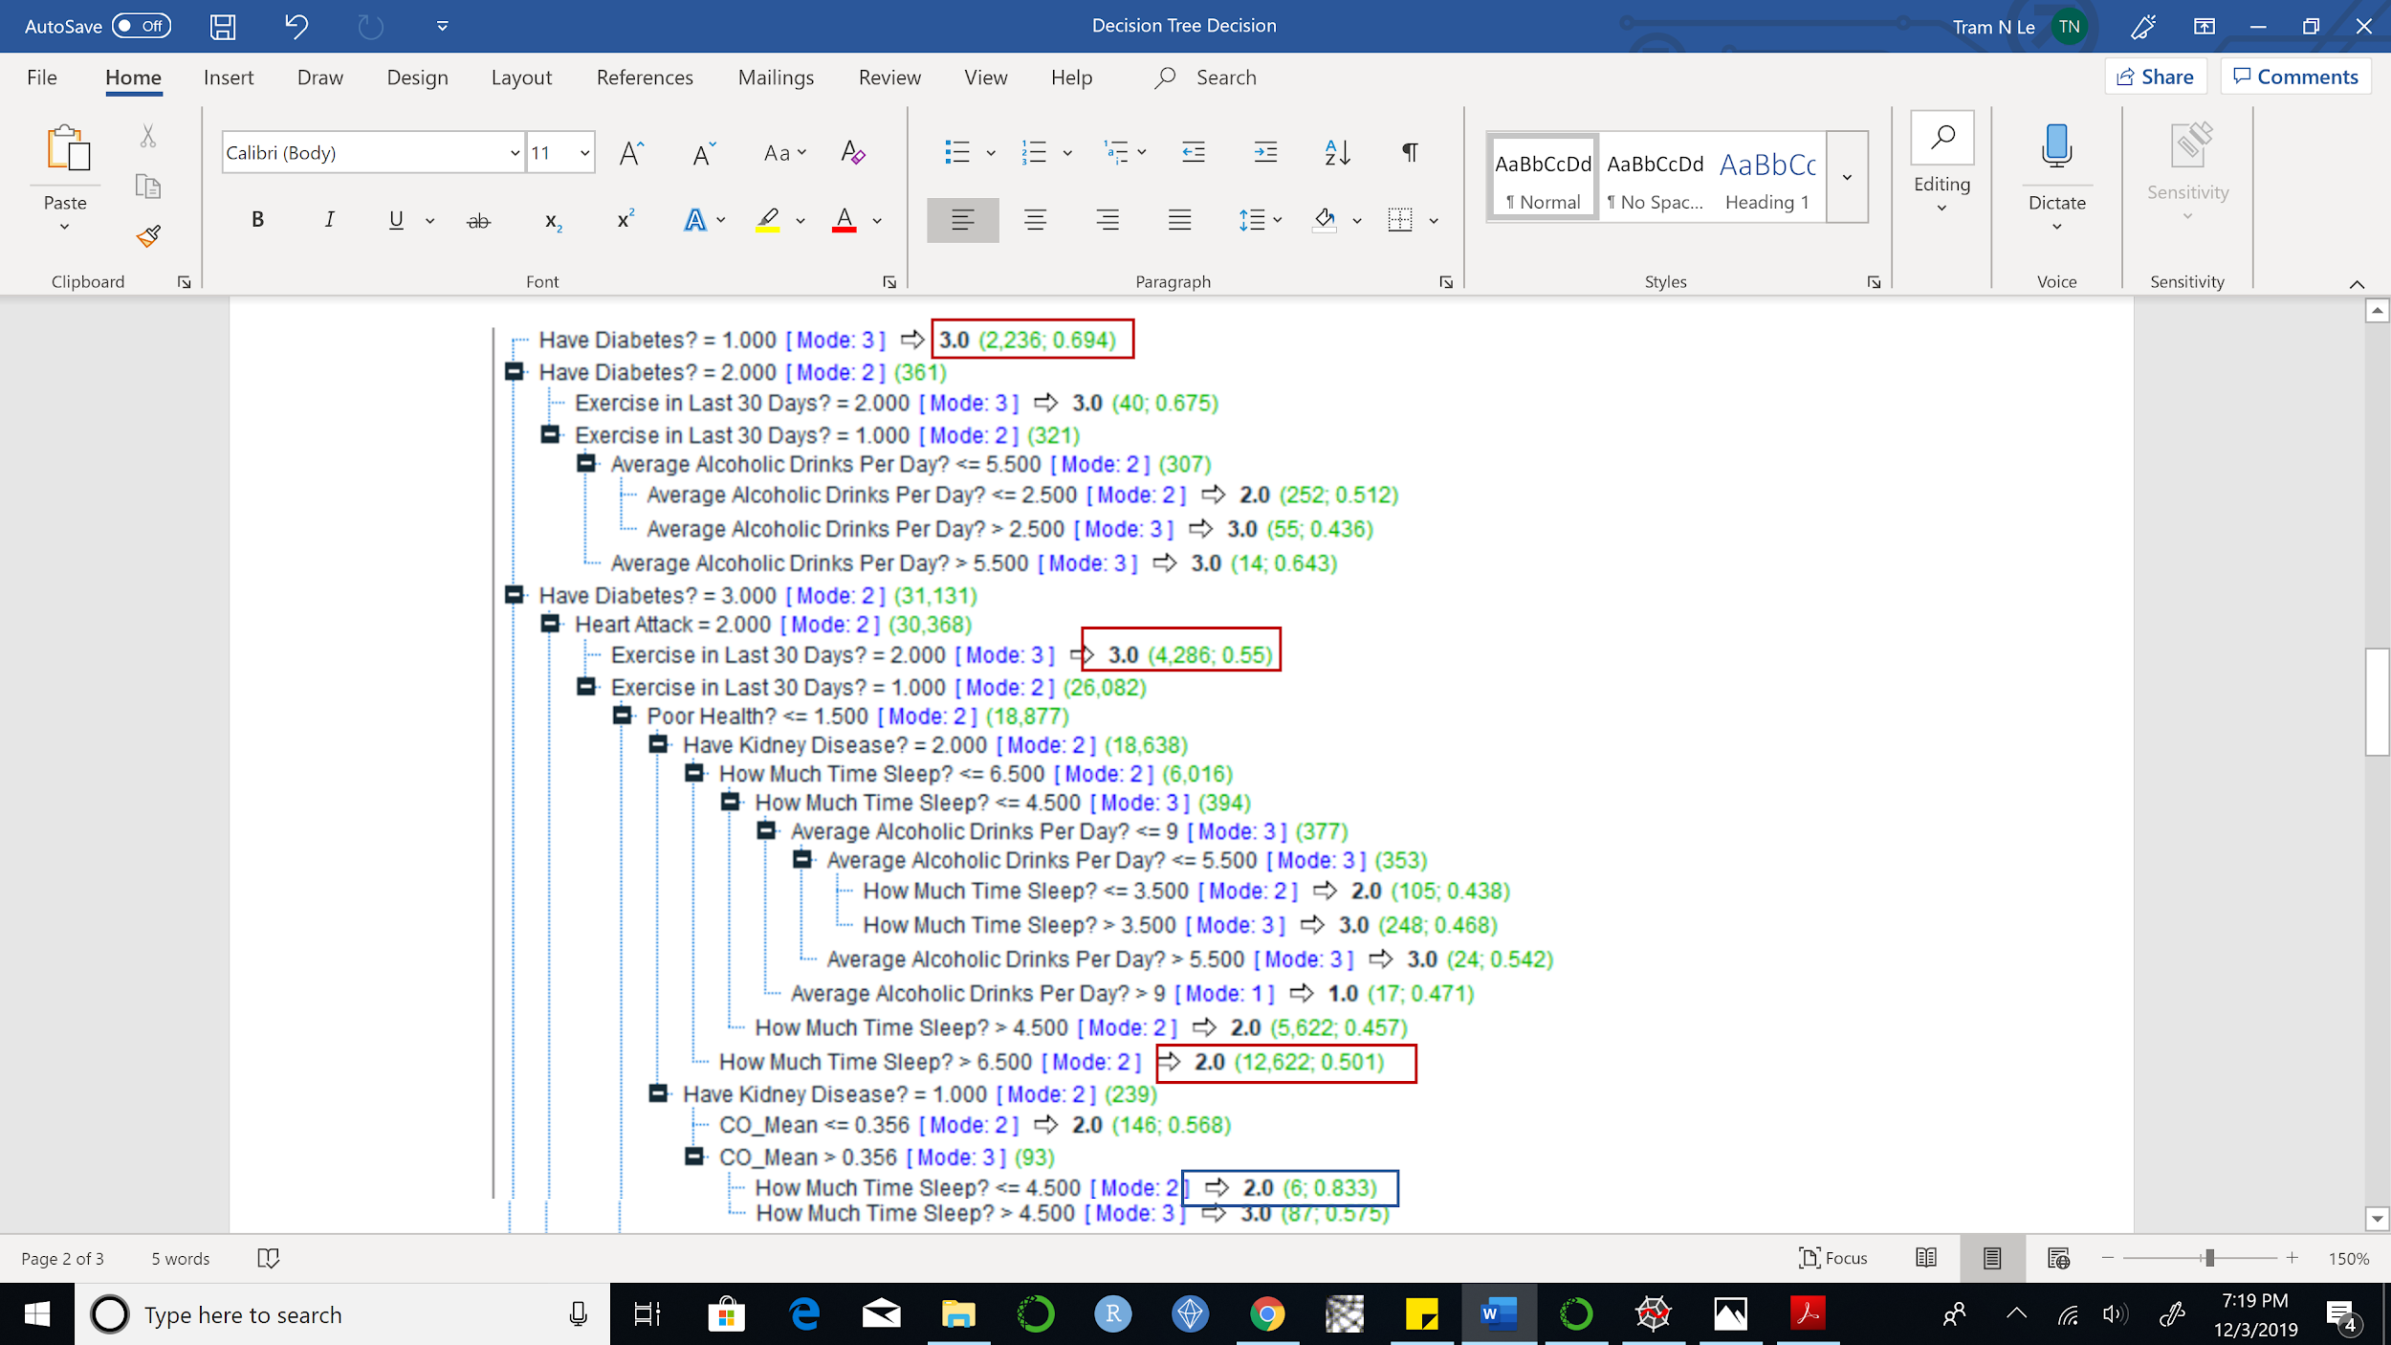
Result Analysis: Decision Tree Rules Examples
General Health Rating: 2.0 - “Very Good” (12,622 records with 50.1% of accuracy)
General Health Rating: 3.0 - “Good” (2,236 records with 69.4% of accuracy)
General Health Rating: 3.0 - “Good” (4,286 records with 55% of accuracy)
Notes:
Mention that even though there are rules that predicts general health rating target 2.0 with accuracy is 83.3 percentage but the sample size is only 6 - so the results are not significant enough. On the contrary, the accuracy is only about 50% for large records.
General Health Rating: 2.0 - “Very Good” (12,622 records with 50.1% of accuracy):
Not being told have diabetes
Never have heart attack
Do exercise in the last 30 days
Have around 1 days of poor physical or mental health
Don’t have kidney disease
Sleep more than 6.5 hours
General Health Rating: 3.0 - “Good” (2,236 records with 69.4% of accuracy):
Have diabetes
General Health Rating: 3.0 - “Good” (4,286 records with 55% of accuracy):
Not being told have diabetes
Don’t have heart attack
Don’t exercise in the last 30 months

Slide 20
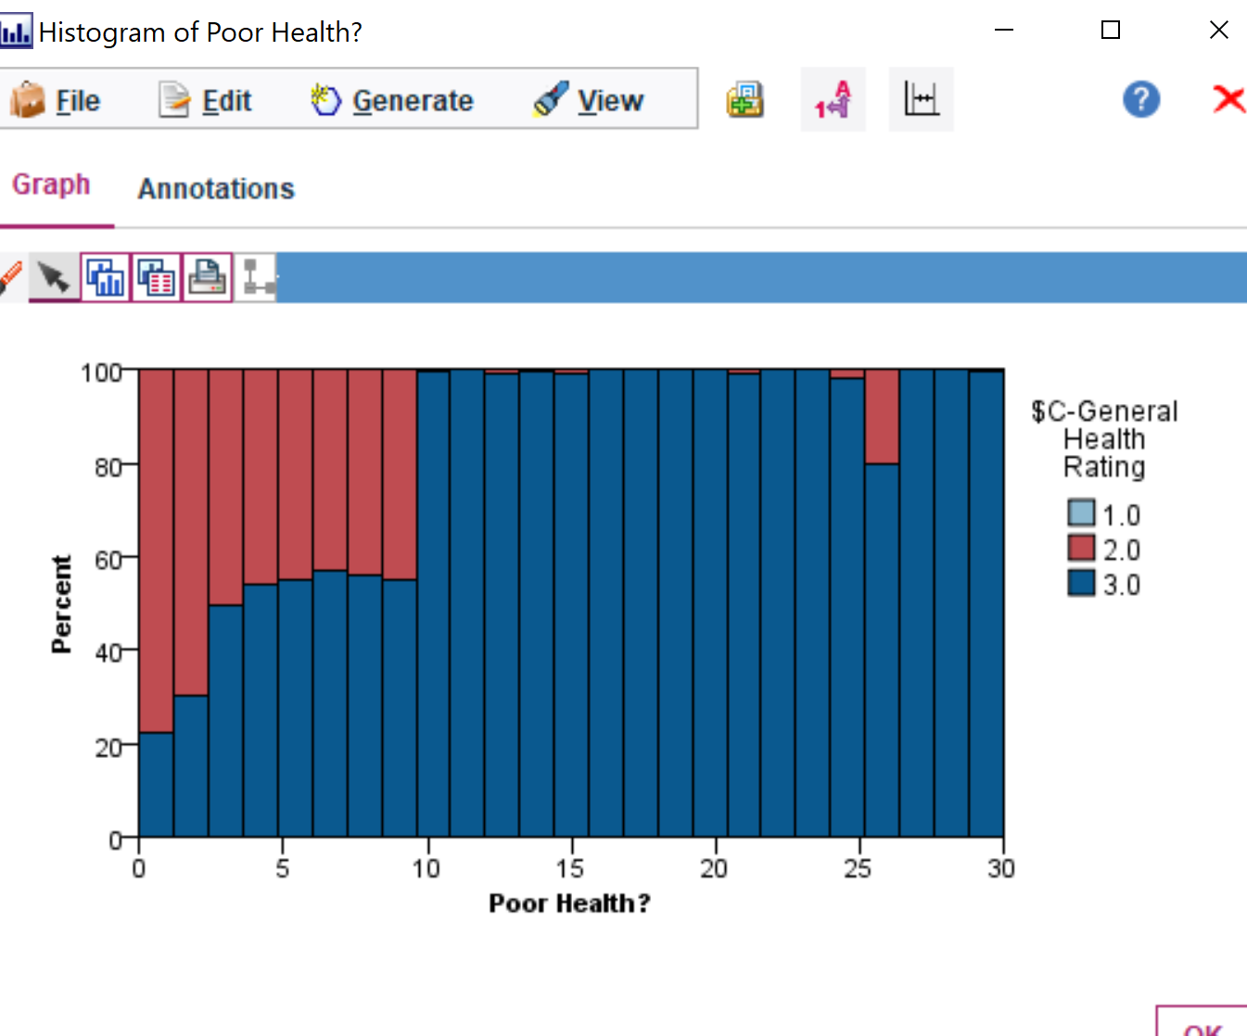
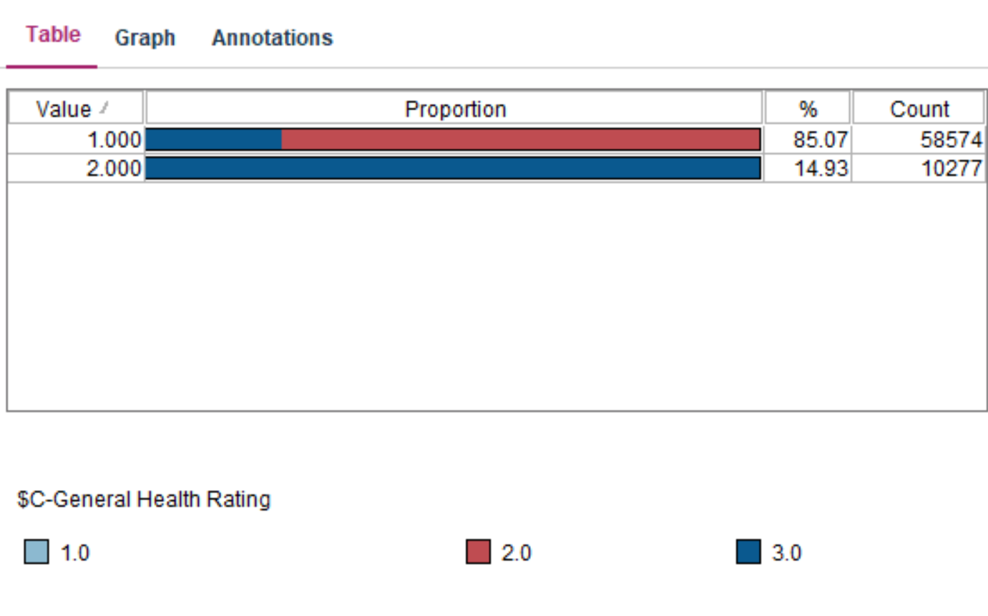
Result Analysis: Decision Tree Visualization
Figure 2. Exercise in The Last 30 Days Distribution
Figure 1. Days of Poor Physical and Mental Health Histogram
Notes:
People still considered they have a good rating even though they can have up to 30 days of poor physical and poor mental health.
People considered their health very good if they exercised in the last 30 days
These graph are distribution and histogram model based on our predictor indicators - However the accuracy is not very high in classification.

Slide 21
CONCLUSION

Slide 22

Conclusion
Decision Tree – Better Model
Limitation & Constraint
Managerial Perspective
Notes:
Decision Tree can predict factors what make people rate their health as “very good” with an accuracy rate of roughly 72%.
Due to the unequally distributed sample size for each type of targets:
The model cannot predict what make people rate their health as “excellent”
The model perform poorly on predicting factors that make people rate their health as “good”
From managerial perspective, the decision tree can be used if only more data will be collected for other type of targets. At this point, we cannot predict correctly what affects people’s opinions about their health.

Slide 23

Question?

Slide 24
APPENDIX

Slide 25
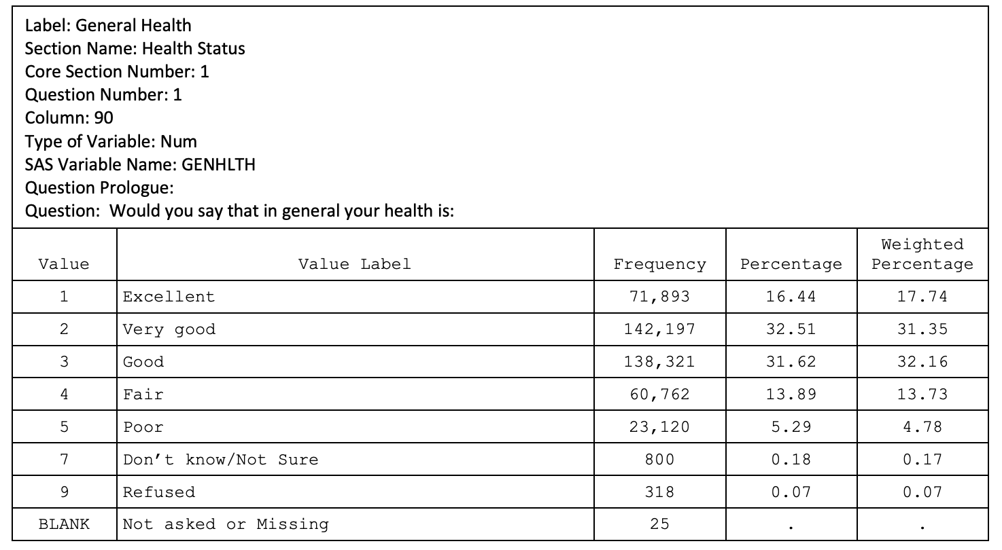
Source Node: BRFSS 2018
Data Source: https://www.cdc.gov/brfss/annual_data/annual_2018.html
Questionnaire includes questions on demographic characteristics, and current health behaviors
Over 300 questions are asked in the questionnaire
Over 400,000 people answered the questionnaire. However, we only chose people who considered themselves ‘Excellent’, ‘Very Good’ and ‘Good’, which is about 70% of the data.
People can answer ‘Don’t know’ or refuse to answer, or answer was not recorded due to some mistake. Thus, those values did not contribute to the data and were discarded.

Slide 26
Source Node: Pollution.csv
NO2 Mean -- Range: [-2.00, 139.54]; Average: 12.82
O3 Mean -- Range: [0.0, 0.10]; Average: 0.03
SO2 Mean -- Range: [-2.0, 321.63]; Average: 1.87
CO Mean -- Range: [-0.44, 7.51]; Average: 0.37
Data Source: https://www.kaggle.com/sogun3/uspollution

Slide 27
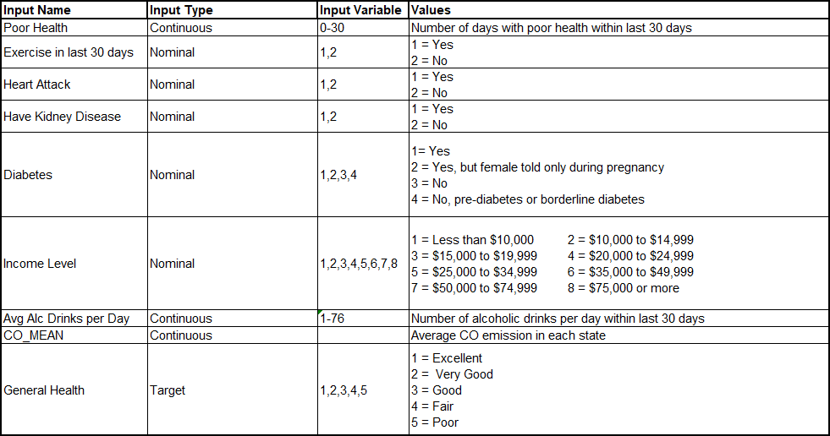
Type Node: Final Input List
Most of the data from BRFSS is coded into numeric values (1,2,3…). So we used the type node to read values and categorize them correctly.
BRFSS 2018 Codebook

Slide 28
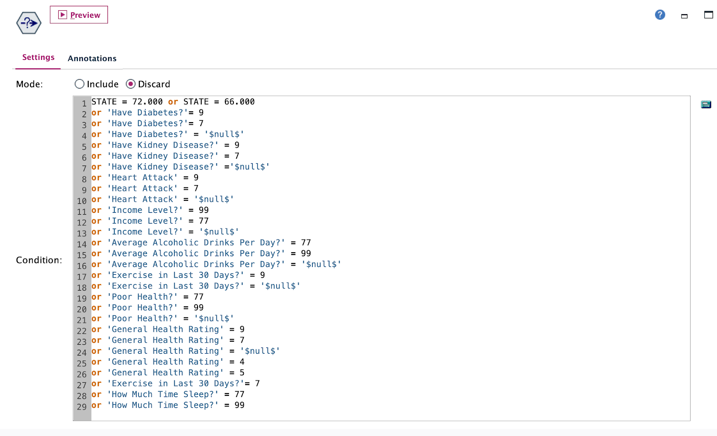
Select Node
We used the Select Node to discard null/ don’t know/ refused to answer values for all our target and input fields.

